Slide 1
Lecture 2: Time Value of Money
Content
Summary
Q1, P8-14 and P8-26
P8-30
P8-35
P8-40
Group Members: Tan Jun Jie Aaron
Cassandra Guo Yixian
Koh Jian Long Kelvin
Liu Yue
Ko Wei Zhe

Slide 2
summary
Time Value of Money
Value of money figuring in a given amount of interest earned over a given amount of time.
In other words, how much a certain amount of money will be worth in the future if we are given a specific amount of interest for that money.

Slide 3

summary
FV of simple compound interest
FV= PV (1 + I) ^{N}
Eg. Deposit $100 into a bank account and allowing it to grow interest annually.
$133.10
10%
10%
10%
$100

Slide 4
summary
Annuities
Series of fixed payments required from you or paid to you at a specified frequency over the course of a fixed period of time.
Ordinary Annuity
Payments are required at the end of each period
Annuity Due
Payments are required at the beginning of each period

Slide 5
summary
PV of Ordinary Annuity or Annuity Due
To understand how to find the PV, think of it as you are putting a lump sum of money into an account then letting interest compound while still getting a fixed payout after every specified period.
Eg. Retirement Account

Slide 6

summary
PV of Ordinary Annuity or Annuity Due
PVA_{N} (Ordinary Annuity) = PMT * [1 – 1/(1 + I)^{N}]/ I
PVA_{due} (Annuity Due)= PMT * [1 – 1/(1 + I)^{N}]/ I * (1 + I)
= PVA_{N} * (1 + I)
$248.69
FV=0
10%
10%
10%
Year 0
$100
$100
$100
$273.55
FV=0
10%
10%
Year 0
$100
$100
$100

Slide 7
summary
FV of Ordinary Annuity or Annuity Due
To understand how to find the FV, think of it as you are putting a specific amount of money into an account every fixed period and withdrawing all the money at the end of all the periods after compounding the interests
Eg. Savings Account

Slide 8
summary
FV of Ordinary Annuity or Annuity Due
FVA_{N} (Ordinary Annuity)= PMT * [(1 + I)^{N} -1]/ I
FVA_{due} (Annuity Due)= PMT * [(1 + I)^{N} -1]/ I * (1 + I)
= FVA_{due} * (1 + I)
PV=0
$331
10%
10%
Year 0
$100
$100
$100
PV=0
$364.10
10%
10%
10%
Year 0
$100
$100
$100

Slide 9
summary
Classifications of interest rates
Nominal rate
NO compounding effect
Interest given for the amount put in
Periodic rate
WITH compounding effect
Interest charged per period
Effective Annual rate (EAR)
WITH compounding effect
To calculate actual interest annually, given a interest charged per period
EAR = (1 + I_{NOM} / M)^{M} - 1

Slide 10
summary
Loans
Bullet Loan
Full principal repaid at maturity
Periodic Interest payments
NO interim repayment of principal
Amortized Loan
Periodic payments which include:
Payment for interest
Partial principal repayment
Eg. Home mortgages, Business loans

Slide 11


Question 1
Formula:
Number Substitution:
EAR_{A} = (1+0.12/2)² -1 = 12.36%
EAR_{B} = (1+0.12/4)⁴ -1 = 12.55%
EAR_{c} = (1+0.035)⁴ -1 = 14.75%
Bank C is chosen as it offers the highest rate of returns.

Slide 12
Question 1
Formula:
Numerical Substitution:
FV = 10,000(1+0.035)^{4x2} = $13,168.09
Calculator Method:
N = 4x2 = 8, I/Y = 3.5, PV = 10,000
FV = 13,168.09
The future value for the savings after 2 years with Bank C is $13,168.09

Slide 13

Question P8-14A
Formula:
Numerical Substitution:
A. FVA = 400/0.1 x [(1+0.1)¹⁰ -1] = $6,374.97
Calculator Method:
N = 10, I/Y = 10, PMT = 400, P/Y = 1
FVA = 6,374.97
The future of the 10-percent annuity is $6,374.97

Slide 14
Question P8-14C
Formula:
Since I/YR = 0,
FVA = PMT x N
Numerical Substitution:
FVA = 400 x 5 = $2,000
Calculator Method:
N = 5, I/YR = 0, PV = 0, PMT = 400
FVA = 2,000
The future value of the 0-percent annuity is $2,000.

Slide 15
Question P8-14D
Formula:
FVA_{due} = FVA_{ord} (1 + I)
Numerical Substitution:
A: FVA_{due} = 6375(1+0.10) = $7,012.47
C: FVA_{due} = 2000(1+0) = $2,000

Slide 16
Question P8-14D
Calculator Method:
A: BGN N = 10, I/YR = 10, PV = 0, PMT = 400
FV = 7,012.47
C: BGN N = 5, I/YR = 0, PV = 0, PMT = 400
FV = 2,000
The annuity due for the 10-percent and 0-percent annuity is $7,012.47 and $2,000 respectively.

Slide 17
Question P8 -14 Extra
For the 0 percent annuity,
FVA_{ord} = $2,000
FVA_{due} = $2,000
Since the annuity interest rate is zero, there will be no compounding effect which affects the future value of the annuities.
Therefore, the future values of the ordinary annuity and the annuity due are equivalent to the value of the total payments made.

Slide 18



Question P8-26
Formula:
Numerical Substitution:
For 48-months loan,
For 60-months loan,

Slide 19
Question P8-26
For 48-months loan,
Value of most expensive car bought = 13,290.89 + 4,000 = $17,290.89
For 60-months loan,
Value of most expensive car bought = 15,734.26 + 4,000 = $19,734.26
Therefore, the most expensive car that I can afford is $17,290.89 should I take up the 48-month auto loan or $19,734.26 should I take up the 60-month auto loan.

Slide 20
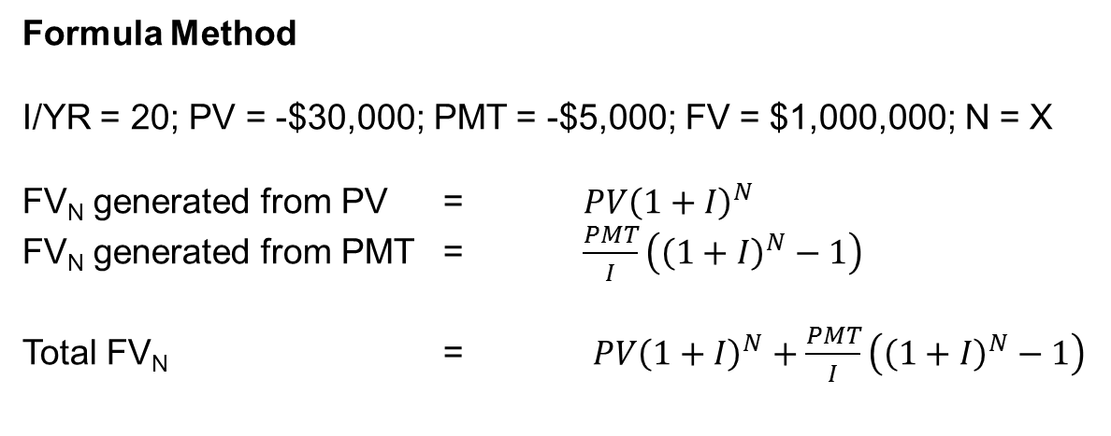
Question P8-30
0
1
2
3
x
20%
-$30,000
-$5,000
-$5,000
-$5,000
FV = $1,000,000
Formula Method
I/YR = 20; PV = -$30,000; PMT = -$5,000; FV = $1,000,000; N = X
FV_{N} generated from PV = $PV{\left(1+I\right)}^{N}$
FV_{N} generated from PMT = $\frac{PMT}{I}\left({\left(1+I\right)}^{N}−1\right)$
Total FV_{N} = $PV{\left(1+I\right)}^{N}+\frac{PMT}{I}\left({\left(1+I\right)}^{N}−1\right)$

Slide 21
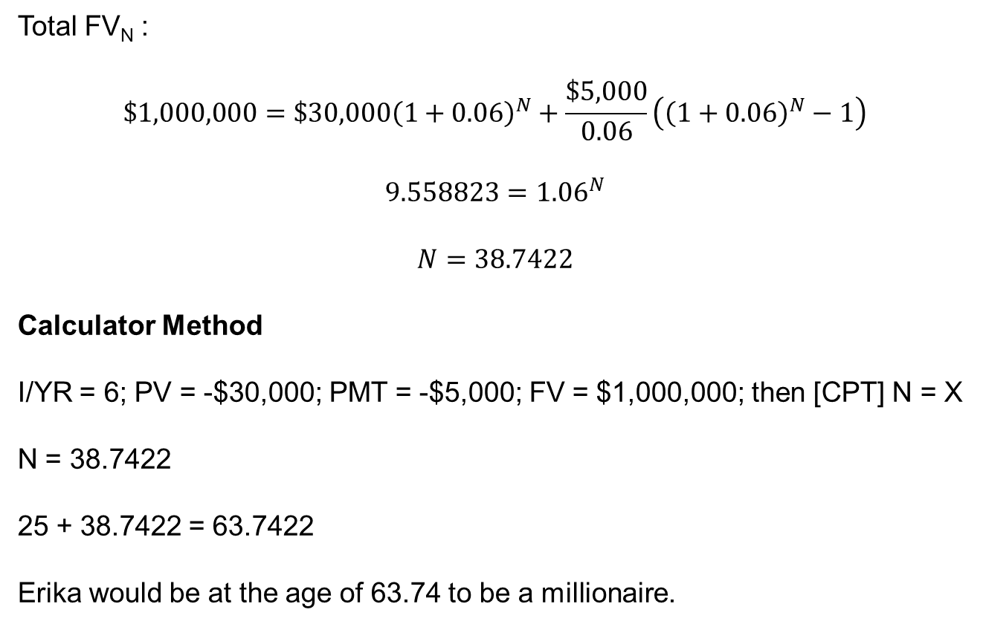
Question P8-30
Total FV_{N} :
$$\$1,000,000=\$30,000{\left(1+0.06\right)}^{N}+\frac{\$5,000}{0.06}\left({\left(1+0.06\right)}^{N}−1\right)$$
$$9.558823={1.06}^{N}$$
$$N=38.7422$$
Calculator Method
I/YR = 6; PV = -$30,000; PMT = -$5,000; FV = $1,000,000; then [CPT] N = X
N = 38.7422
25 + 38.7422 = 63.7422
Erika would be at the age of 63.74 to be a millionaire.

Slide 22
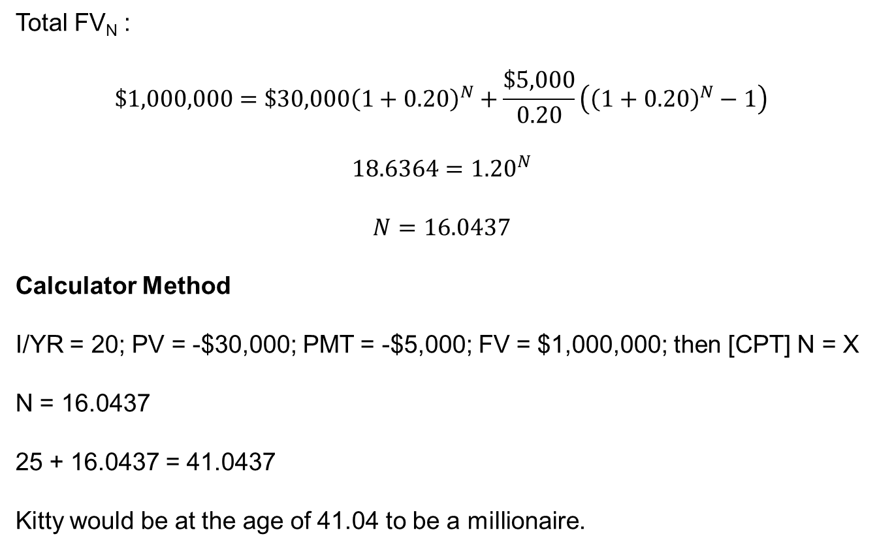
Question P8-30
Total FV_{N} :
$$\$1,000,000=\$30,000{\left(1+0.20\right)}^{N}+\frac{\$5,000}{0.20}\left({\left(1+0.20\right)}^{N}−1\right)$$
$$18.6364={1.20}^{N}$$
$$N=16.0437$$
Calculator Method
I/YR = 20; PV = -$30,000; PMT = -$5,000; FV = $1,000,000; then [CPT] N = X
N = 16.0437
25 + 16.0437 = 41.0437
Kitty would be at the age of 41.04 to be a millionaire.

Slide 23
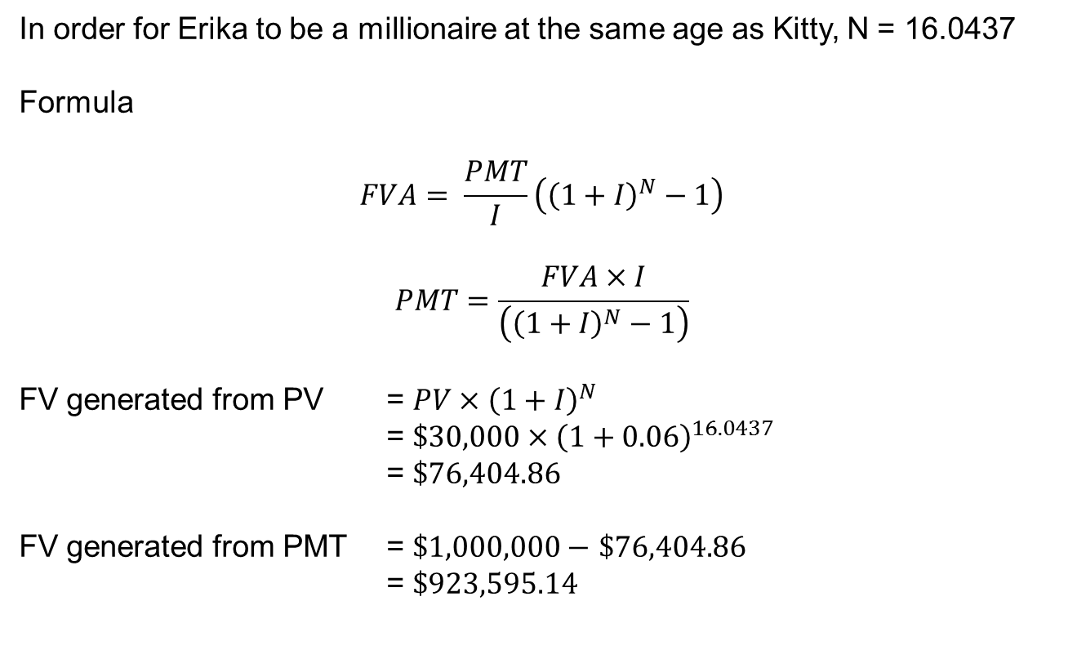
Question P8-30
In order for Erika to be a millionaire at the same age as Kitty, N = 16.0437
Formula
$$FVA= \frac{PMT}{I}\left({\left(1+I\right)}^{N}−1\right)$$
$$PMT=\frac{FVA×I}{\left({\left(1+I\right)}^{N}−1\right)}$$
FV generated from PV = $PV×{\left(1+I\right)}^{N}$
= $\$30,000×{\left(1+0.06\right)}^{16.0437}$
= $\$76,404.86$
FV generated from PMT = $\$1,000,000−$ $\$76,404.86$
= $\$923,595.14$

Slide 24
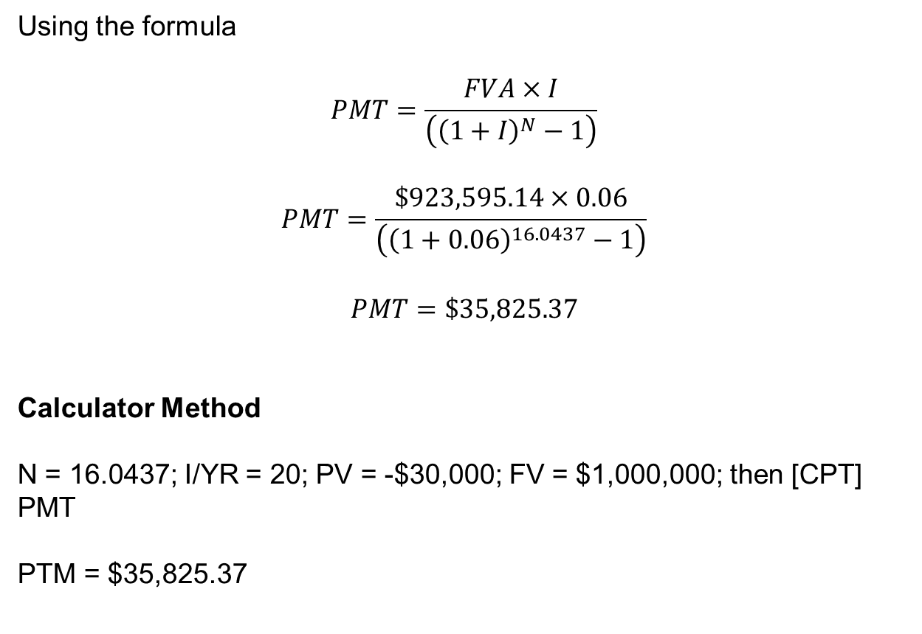
Question P8-30
Using the formula
$$PMT=\frac{FVA×I}{\left({\left(1+I\right)}^{N}−1\right)}$$
$$PMT=\frac{\$923,595.14×0.06}{\left({\left(1+0.06\right)}^{16.0437}−1\right)}$$
$$PMT=\$35,825.37$$
Calculator Method
N = 16.0437; I/YR = 20; PV = -$30,000; FV = $1,000,000; then [CPT] PMT
PTM = $35,825.37

Slide 25

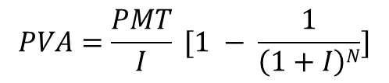


Answer to P8-35a
0
1
2
3
PVA = 90000
PMT
PMT
PMT
PVA = $90000, N = 3 years, Interest = 7%
Finding payment by using formula:
Numerical Substitution:
(Not affordable!)
$$PVA=\frac{PMT}{I} [1 − \frac{1}{\left(1+I\right)N}]$$
90000 $=\frac{PMT}{0.07} [1 − \frac{1}{\left(1+0.07\right)3}]$
PMT $=\frac{90000 ∗ 0.07 }{0.1837021231}$
PMT $=\$ 34294.65$

Slide 26



Answer to P8-35b
0
1
2
3
15
30
90000
PMT
PMT
PMT
PMT
PMT
PVA = $90000, N = 30 years, Interest = 7%
Finding payment by using formula:
Numerical Substitution:
(Affordable!)
$$PVA=\frac{PMT}{I} [1 − \frac{1}{\left(1+I\right)N}]$$
90000 $=\frac{PMT}{0.07} [1 − \frac{1}{\left(1+0.07\right)30}]$
PMT $=\frac{90000 ∗ 0.07 }{0.8686328828}$
PMT $=\$ 7252.78$

Slide 27
Alternative method to P8-35a & b
Calculator method:
P8-35a:
P8-35b:
END MODE
INPUTS | 3 | 7 | 90 000 |  | 0
 | N | I/YR | PV | PMT | FV
OUTPUTS |  |  |  | -34,294.65
END MODE
INPUTS | 30 | 7 | 90 000 |  | 0
 | N | I/YR | PV | PMT | FV
OUTPUTS |  |  |  | -7,252.78

Slide 28
Answer to P8-35c
Known values:
Beginning Balance for year 1→ $90000
Yearly Payment → $7252.78
Interest rate per year → 7%
Loan balance after 3 years = $86936.91
Balloon Payment = Payment in 3rd year + Loan Balance
= 7252.78 + 86936.91
= $ 94189.69
Year | BEG BAL ($) | PMT ($) | INT ($) (BEG BAL* I/R) | PRIN REPAY ($) (PMT – INT) | END BAL ($) (BEG BAL – PRIN)
1 | 90000 | 7252.78 | 90000 * 7/100 = 6300 | 7252.78 – 6300 = 952.78 | 90000 – 952.78 = 89047.22
2 | 89047.22 | 7252.78 | 89047.22 * 7/100 = 6233.31 | 7252.78 – 6233.31 = 1019.47 | 89047.22 – 1019.47 = 88027.75
3 | 88027.75 | 7252.78 | 88027.75 * 7/100 = 6161.94 | 7252.78 – 6161.94 = 1090.84 | 88027.75 – 1090.84 = 86936.91

Slide 29
Answer P8-40 Required Annuity Payments
College Years
13
14
15
16
17
18
19
20
21
Information Available
School Fees
University Fee at Age of 13 | $15,000.00
Inflation Rate | 5% per Year
Years Before Enter University | 5 Year
Saving Plan
Initial Value | $7,500.00
Interest Rate | 6% per Year

Slide 30
Answer P8-40 Required Annuity Payments
Step 1: Calculate tuition fee at each academic year
13
14
15
16
17
18
19
20
21
I=5%
PV = $15,000.00
College Years
To calculate the tuition fee in each year
At age of 18

Slide 31
Answer P8-40 Required Annuity Payments
By Using Financial Calculator, at age 18,
END MODE
INPUTS
5
5
-15,000.00
0
N
I/YR
PV
PMT
FV
OUTPUTS
19,144.22
Year of Study |  | Tuition Fee
1 |  | $19,144.22
2 |  | $20,101.43
3 |  | $21,106.50
4 |  | $22,161.83

Slide 32
Answer P8-40 Required Annuity Payments
Uneven Cash Flow
By now we already know that
College Years
13
14
15
16
17
18
19
20
21
I=5%
$19,144.22
$20,101.43
$22,161.83
$21,106.50
PV = $15,000.00
Total Money Saved = Total University Cost

Slide 33
Answer P8-40 Required Annuity Payments
Step 2: Calculate total PVA in the saving account
Considering there is 6% earned each year from the saving plan even during school term
College Years
18
19
20
21
I=6%
$19,144.22
$20,101.43
$21,106.50
$22,161.83
$18,963.61
$18,784.71
$18,607.50
$75,500.00
Thus, amount needed by school start = $75,500.00

Slide 34
Answer P8-40 Required Annuity Payments
By now we already know,
13
14
15
16
17
18
19
20
21
$7,500.00
$19,144.22
$18,963.61
$18,784.71
$18,607.50
Initial deposit of $7,500.00 will increase in value with 6 percent interest rate for next 5 years
$75,500.00
College Years
The saving account must at least, hold $75,500.00 at this year

Slide 35
Answer P8-40 Required Annuity Payments
Step 3: Calculate the future value of $7,500.00 deposit
As $7,500.00 are already in the saving account, accounting the 5 years interest earned
By using Financial Calculator,
END MODE
INPUTS
5
6
-7,500.00
0
N
I/YR
PV
PMT
FV
OUTPUTS
10,036.69

Slide 36
Answer P8-40 Required Annuity Payments
Step 4: Calculate the yearly payment required
Information Available
Present Value | 0
Interest Rate | 6% per Year
Number of Period | 6
PVA₁₈ | $75,500.00
FV_{18,7500} | $10,036.69
FVA | Unknown
13
14
15
16
17
18
PMT
PMT
PMT
PMT
PMT
PMT
* Note that first payment will be make on age of 13 and last payment will be make on age of 18
FVA= ?

Slide 37
Answer P8-40 Required Annuity Payments
Information Available
Present Value | 0
Interest Rate | 6% per Year
Number of Period | 6
FVA | $65,463.30
13
14
15
16
17
18
PMT
PMT
PMT
PMT
PMT
PMT
FVA= $65,463.30

Slide 38
Answer P8-40 Required Annuity Payments
By Using Financial Calculator,
END MODE
INPUTS
6
6
0
65,463.30
N
I/YR
PV
PMT
FV
OUTPUTS
-9,384.99
In conclusion, the yearly commitment, PMT, needed is $9,384.99

